Slide 1
December 16, 2022 presentation to
Ad Hoc State Agency Workgroup on Hunger
THE TRUE COST OF FOOD
01
Improving food procurement by public agencies in NYS

Slide 2
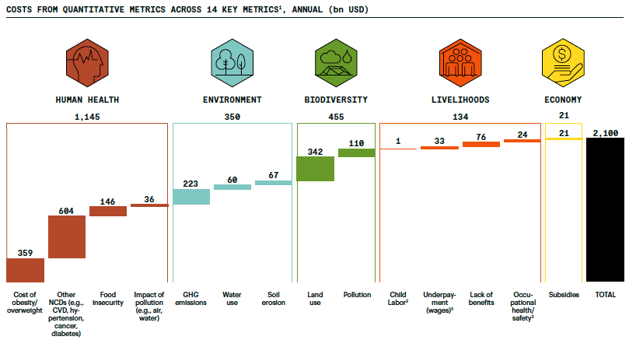
THE TRUE COST OF FOOD PROJECT
02
The true cost of our food system is three times higher than expenditure on food
Rockefeller Foundation 2021
Notes:
Template slide 2

Slide 3
THE TRUE COST OF FOOD PROJECT
Current law requires state agencies procure food from the lowest qualified bidder.
But these prices don't reflect important (positive and negative) externalities like greenhouse gas emissions, nutrition, and job creation.
This hides the true, longer-term cost of food to New York taxpayers.
And it disadvantages NY producers/processors.
03
$1.2B
The amount New York state agencies spend each year purchasing food.

Slide 4
THE TRUE COST OF FOOD PROJECT
We’re exploring how modifying procurement practices can be a cost-effective policy proposition.
Modifications could lead to gains in several sectors, reducing future fiscal expenditures on curative health care, environmental remediation, and social safety nets.
Can also level the playing field for NY enterprises competing w/external vendors facing lower standards.
Project
Overview
04

Slide 5
THE TRUE COST OF FOOD PROJECT
Integrated workstreams
This research aims to quantify and correct for the true cost of food procured by state agencies in New York by developing a mechanism to transparently adjust procurement bids to account for these costs. The project, to complete by October 2023, has three stages of integrated work streams.
05

Slide 6
THE TRUE COST OF FOOD PROJECT
Spillover costs
06
Estimate the environmental, fiscal, health and other spillover costs of food procured by NYS agencies.

Slide 7
THE TRUE COST OF FOOD PROJECT
Framework for bids
07
Develop a framework for adjusting food vendors’ bids to incorporate these multipliers and spillover costs.

Slide 8
THE TRUE COST OF FOOD PROJECT
Communicate & implement
08
Engage with NYS agencies and food vendors in implementing and refining the true cost framework in public food procurement.

Slide 9
THE TRUE COST OF FOOD PROJECT
What food products are most important to your agencies in terms of total annual spending?
09
Notes:
Chris’ ask

Slide 10
THE TRUE COST OF FOOD PROJECT
Interested in engaging with us in spring/summer 2023 to discuss?
10
Implementation options for bid adjustment algorithms
Thinking through implications for state agencies (and those, like school districts, using state or federal pass-through funding) and the communities you serve
Notes:
Chris’ ask

Slide 11
The
Co-PIs
THE TRUE COST OF FOOD PROJECT
11
Mario Herrero
Chris Barrett
Todd Schmit
Brad Rickard
Co-Principal Investigator
Nancy and Peter Meinig Family Investigator in the Life Sciences
Department of Global Development
Cornell Atkinson Center for Sustainability Scholar
Co-Principal investigator
Stephen B. and Janice G. Ashley Professor
Charles H. Dyson School of Applied Economics and Management and
Jeb E. Brooks School of Public Policy
Co-Principal Investigator
Professor
Charles H. Dyson School of Applied Economics and Management
Co-Principal Investigator
Professor
Charles H. Dyson School of Applied Economics and Management

Slide 12
The
team
THE TRUE COST OF FOOD PROJECT
Kerstin Damerau
Cynthia Mathys
Nicole Rossi
12
Research Associate
Cornell Food Systems & Global Change
Senior Project Manager
Cornell Food Systems & Global Change
Communications Manager
Cornell Food Systems & Global Change
Jialu Li
Xiaoyan Liu
Maria DiGiovanni
Graduate Research Assistant
MPA Candidate
Cornell Jeb E. Brooks School of Public Policy
Graduate Research Assistant
MS Candidate
Charles H. Dyson School of Applied Economics and Management
Undergraduate Research Assistant,
International Agriculture and Rural Development
College of Ag & Life Sciences

Slide 13
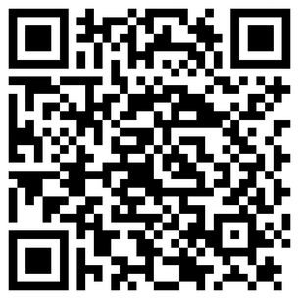
THE TRUE COST OF FOOD PROJECT
Learn more
cals.cornell.edu/food-systems-global-change/true-cost-food
13

Slide 14
THE TRUE COST OF FOOD PROJECT
Thank you
14
Mario Herrero
Chris Barrett
Brad Rickard
Todd Schmit
mh2258@cornell.edu
cbb2@cornell.edu
bjr83@cornell.edu
tms1@cornell.edu
www.cals.cornell.edu/food-systems-global-change/true-cost-food

